Slide 1

The Pedagogic Cybersecurity Framework and the Non-Code Aspects of Cybersecurity
Professor Peter Swire
Scheller College of Business
Alston & Bird LLP
WEIS Keynote
June 3, 2019

Slide 2
A Challenge, familiar to WEIS Participants
“Real” cybersecurity, for many computer scientists
  “Real” cybersecurity is about writing code and doing technical work
  The non-code, or “soft”, issues have not been central to the task of “real” cybersecurity
  Vague approval of “inter-disciplinary” studies for cybersecurity
    But, with a lower priority than “real” cybersecurity
The Workshop on the Economics of Information Security (WEIS)
  “Is the leading forum for interdisciplinary scholarship on information security and privacy, combining expertise from the fields of economics, social science, business, law, policy, and computer science”

Slide 3
Overview
Recent CACM article on categorizing the non-code aspects of cybersecurity risk and mitigation
  Ongoing research, including for privacy
Extend the OSI stack to layers 8 (organizations), 9 (law), and 10 (international)
  CACM article calls this the “Pedagogic Cybersecurity Framework”
  Create 3x3 matrix for categorizing non-code cybersecurity topics, useful for both technical and less technical audiences
Today’s focus:
  Show how the framework helps categorize and clarify the research issues that WEIS addresses
  Hopefully, suggests relevant literatures and tasks for each cell of the 3x3 matrix

Slide 4
Swire Background
Since 2013 Georgia Tech: Scheller College of Business, courtesy in College of Computing & Public Policy
  Policy, GT Institute for Information Security and Privacy, and teach those
  Senior Counsel, Alston & Bird LLC
Law professor beginning 1990
  First article on law of the Internet in 1992
  Book on EU/US privacy & Financial Crypto 1998
  Clinton Administration Chief Counselor for Privacy, 1999-2000
    HIPAA, GLBA, encryption, intrusion detection and cybersecurity
  Taught “Law of Cybersecurity” 2004

Slide 5
Swire (2)
2009-2010, Special Assistant to the President for Economic Policy (Larry Summers)
2012-2013, Do Not Track
2013: post - Snowden, Review Group on Intelligence and Communications Technologies
  Led to USA Freedom Act and multiple NSA/surveillance reforms
Currently, lead Cross-Border Data Forum – government access requests across borders while preserving privacy

Slide 6
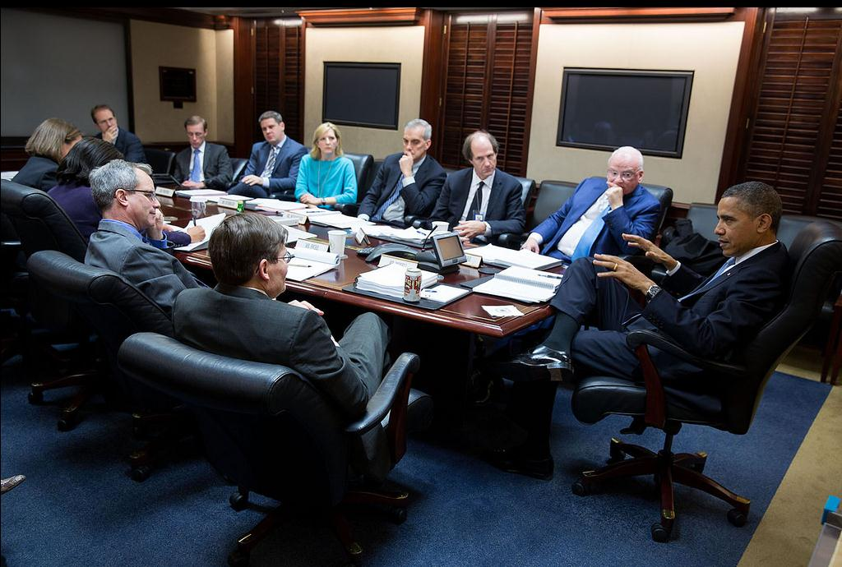
The Situation Room: December 2013

Slide 7
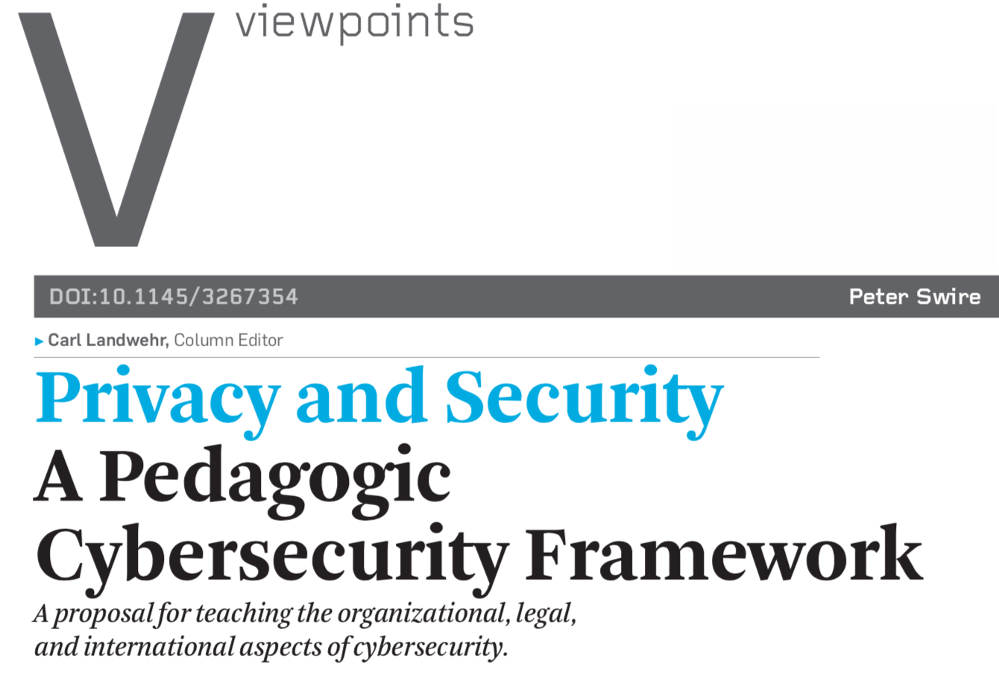

Published 9/26/18

Slide 8
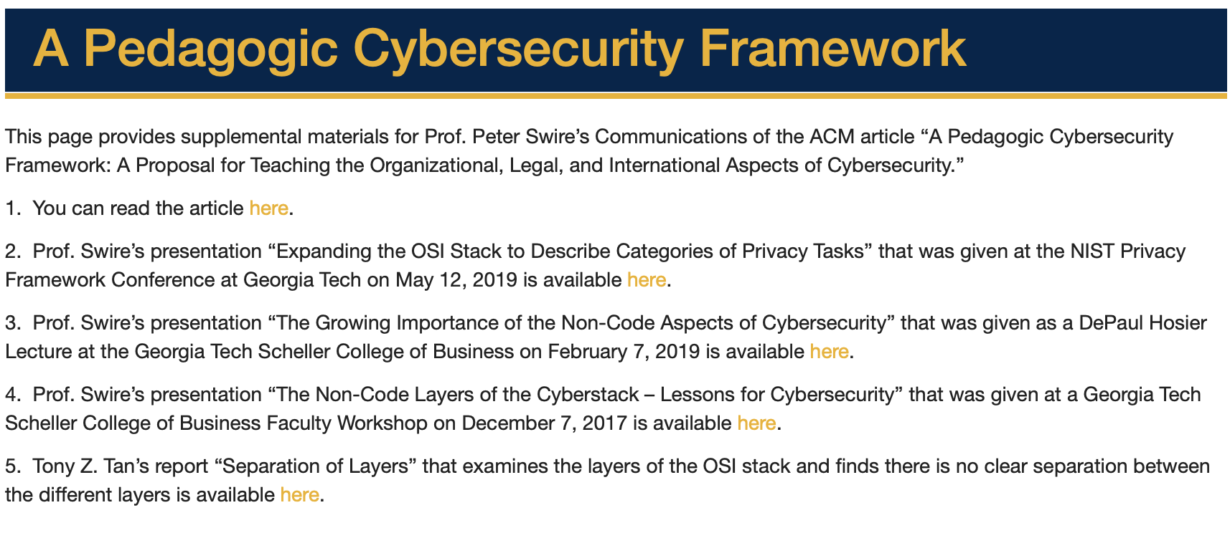
http://peterswire.net/cacm2018faqs-html
Emphasis today: beyond pedagogy - the Framework in
support of cybersecurity research

Slide 9
Theme of New Article:
Growth in Non-Code Cybersecurity
“Real” cybersecurity today devotes enormous effort to non-code vulnerabilities and responses.
The Cybersecurity Workforce Framework of the National Initiative for Cybersecurity Education lists 33 specialty areas for cybersecurity jobs. Ten of the specialty areas primarily involve code, but more than half primarily involve non-code work (15 areas, in my estimate) or are mixed (eight areas, per my assessment).

Slide 10
The Genesis of this Project
MGMT/CoC/PubPol 4726/6726 “Information Security Strategies and Policy”
  I just taught this course for the sixth time
  Required for Georgia Tech Masters in Information Security
  How do all the pieces of this course fit together? Now – 3 parts of the course
    Corporate cybersecurity policies and governance – e.g., draft ransomware policy for a hospital group
    Government laws/regulations – e.g., proposed state or federal IoT legislation
    Nation state and international – draft National Security Council memo on cyberthreats from Russia and policy options to respond

Slide 12
Seven Layers of the OSI “Stack”
In my experience, these seven layers are well known to knowledgeable
computer people who work on cybersecurity. Intuitively, they also know
that cyber-attacks can happen at any of these 7 levels.

Slide 13
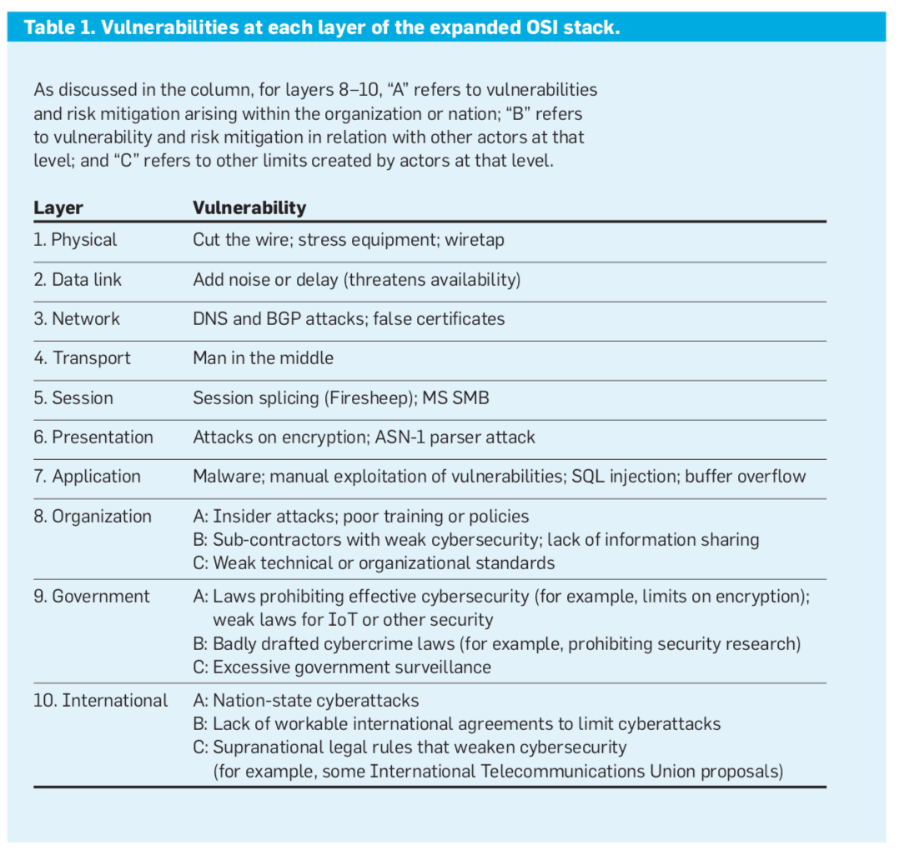

Slide 14
Layers 8, 9, and 10: Natural Language
Layer 10 | International | Natural language | Diplomacy
Layer 9 | Governmental | Natural language | Law
Layer 8 | Organizational | Natural language | Contracts
Layers 1-7 | OSI stack | Computer Code | Various protocols
Question for WEIS: what literatures are relevant
to creating better/optimal contracts, laws, and diplomacy?

Slide 15
Layer 8: Cyber within Organizations:
Management/Business/Econ
 | Within the Organization | Relations with Other Actors | Other Limits on Private Sector
Examples of cyber law and policy | Incident response plans & other internal policies Training Cyber hygiene Roles, such as CISO Users’ precautions | Vendor & other contracts & management Cyber-insurance Private-sector information sharing (ISACs) | PCI-DSS and other industry standards Technical standards such as IETF

Slide 16
Layer 8: Cyber within Organizations:
Management/Business/Econ
 | Within the Organization | Relations with Other Actors | Other Limits on Private Sector
Examples of cyber law and policy Literatures | Incident response plans & other internal policies Training Cyber hygiene Roles, such as CISO Users’ precautions Jensen & Meckling, nexus of contracts Williamson, “hierarchy” ROI/business | Vendor & other contracts & management Cyber-insurance Private-sector information sharing (ISACs) Jensen & Meckling Wlliamson “markets” Empirical econ for effective contracts ROI/business | PCI-DSS and other industry standards Technical standards such as IETF Political science & econ of standard setting

Slide 17
Layer 9: Government Layer: Law Schools & Public Policy Schools
 | Within the Organization | Relations with Other Actors | Limits on Government
Examples of cyber law and policy | HIPAA, GLBA, and other cyber rules (80+ countries) Data breach laws spreading Rules limiting strong encryption | What counts as computer hacking crime? Public-private partnerships and information sharing | Constitutional and statutory limits on what the state can do, such as illegal surveillance

Slide 18
Layer 9: Government Layer: Law Schools & Public Policy Schools
 | Within the Organization | Relations with Other Actors | Limits on Government
Examples of cyber law and policy Literatures | HIPAA, GLBA, and other cyber rules (80+ countries) Data breach laws spreading Rules limiting strong encryption Welfare econ (market failures) Public choice (government failures) | What counts as computer hacking crime? Public-private partnerships and information sharing Criminology and empirical research Political theory of public vs. private | Constitutional and statutory limits on what the state can do, such as illegal surveillance Constitutional law of checks & balances Surveillance studies (sociology/culture)

Slide 19
Layer 10: International Layer: International Relations/Military
 | Within the Nation | Relations with Other Nations | Other Limits on Nations
Examples of cyber law and policy | Unilateral cyber actions, on spectrum from war to “cyber-peace” - Huawei Deterrence against aggressive cyberattacks | Formal treaties & less formal agreements, such as MLATs and US/China trade secrets Cooperation with other nations on attacks and defense | Possible supra-national rules, such as by UN or ITU (China and Russia favor this)

Slide 20
Layer 10: International Layer: International Relations/Military
 | Within the Nation | Relations with Other Nations | Other Limits on Nations
Examples of cyber law and policy Literatures | Unilateral cyber actions, on spectrum from war to “cyber-peace” - Huawei Deterrence against aggressive cyberattacks Realist international relations, to meet national goals Military studies | Formal treaties & less formal agreements, such as MLATs & US/China trade secrets Cooperation with other nations on attacks and defense IR/diplomacy Tragedy of the commons - global commons of high cyber risk | Possible supra-national rules, such as by UN or ITU (China and Russia favor this) Political theory of supranational institutions International law/human rights

Slide 21
Potential for the Cyber Curriculum
Helps describe what topics are done in which course:
  Mostly international relations and cyber norms, and course covers 10A, 10B, and 10C, with some layer 9
  Mostly corporate governance for CISOs, lots of 8A and 8B, with a little bit of the others
  An overall curriculum for a master’s program could determine how full the coverage is of the 3x3 matrix
Can also shift from a project course (reacting to new developments) to a lecture course or treatise/manual:
  Chapter on each cell of the 3x3 matrix, with typical vulnerability and governance issues for each cell
  For instance, 9A and compare market approaches to HIPAA or GLBA; if govern badly, then sensitive data is breached

Slide 22
Practitioner implications
Cybersecurity team is used to thinking about layers 1 to 7
With the expanded OSI stack:
  Spot the risks and mitigations for each part of layers 8 to 10
  Define the skill sets needed for your team
    Draw on the relevant expertise in organizational behavior, law, and international relations as needed

Slide 23
The Framework and Research
Shows the importance of WEIS topics to traditional computer scientists
  The growth of non-code aspects of cybersecurity
Helps organizes the thinking of WEIS researchers
  Which risks & mitigations
  Which academic literatures (what goes into a general exam?)
  What empirical or other research would pay off for cells 9A (welfare economics) or 10B (diplomacy)
Perhaps, offers a “keyword” approach
  In submitting papers, say is mostly 8A (management) or 10C (international organizations)
  For panels or specialized conferences, helps define scope

Slide 24
Conclusion (1) : The Framework for Non-Code Aspects of Cybersecurity
Attacks can happen at layers 8, 9, and 10, if the company has bad policies, the nation has bad laws, or the international community does not prevent attacks
  Vulnerabilities at layers 8, 9, and 10 thus fundamentally similar to vulnerabilities at layers 1 to 7
  My computing & business students, by end of the course, agree that a large part of the current cyber threat is at these layers
Thus, we need a new mental model for the non-code aspects of cybersecurity, to help students, teachers, researchers, practitioners, and policy-makers

Slide 25
Conclusion (2): Pedagogic Cybersecurity
Framework
For the WEIS community in particular, the PCF offers a parsimonious structure to clarify the role of WEIS research:
  Provides categories for the “Interdisciplinary scholarship on information security and privacy, combining expertise from the fields of economics, social science, business, law, policy, and computer science.”
  All of these literatures fit within the Framework

Slide 26
Conclusion (3): Pedagogic Cybersecurity
Framework
The three levels map the domain:
  Organizational (private sector)
  Legal (public sector – a nation writes the laws)
  International (where no one nation writes the laws)
That offers hope/confirmation that the Framework maps the domain
  The full set of risks/mitigations is covered

Slide 27
Finally
“CIA” as a triumph of learnable cybersecurity
  Confidentiality, integrity, and availability
  The community knows to look for all three
Perhaps the PCF could help with learning the non-code aspects of cybersecurity
  Organizational
  Legal
  International
Suggestions for improvement most welcome
  But perhaps this version is learnable by your students and workable for your research
Thank you

