Slide 1
Webinar: Sustainable and Responsible Critical Mineral Supply Chains
23 January 2024

Slide 2
To be secure, supply chains must be sustainable and responsible
Growing pressure to develop new mines, processing facilities and refineries brings increased risk of harm to the environment, workers, communities, Indigenous Peoples and societies
Alongside efforts to reduce demand and increase circularity, it is imperative to mitigate these risks to minimise harm to people and the environment
Failure to address these risks can
Limit market access or create legal barriers when regulatory requirements cannot be met
discourage investment in new projects
Damage reputation, deterring investors and buyers
increase the likelihood of opposition from local communities and other stakeholders
cause acute supply disruptions
Together, this may hinder the scale-up of clean energy technologies and limit progress on climate and clean energy security

Slide 3
Five key recommendations for policy makers
Ensure legal and regulatory protections for the environment, workers, Indigenous Peoples and communities, supported by sufficient means of implementation and enforcement regimes
Channel public spending to encourage the development of better practices and to incentivise good performance
Strengthen the collection and reporting of granular and standardised data to enable benchmarking and progress tracking across the industry and throughout the supply chain
Ensure companies improve transparency throughout the supply chain, including by enhancing traceability, undertaking due diligence and reporting publicly on risks and mitigation actions
Support the development of initiatives that help companies demonstrate that their operations are sustainable and responsible while ensuring cross-compatibility and interoperability
1
2
3
4
5

Slide 4
Focus areas with important implications for supply security
Environmental
Social
Governance
Water
Human rights
Corruption
Greenhouse gas emissions
Community engagement
Biodiversity
While all types of environmental, social and governance risk can impact availability of supply,
some risks are particularly likely to impact security of supply

Slide 5
Cross-cutting policy recommendations
Regulations
Public spending
Data
Transparency
Sustainability standards
Consider including targets for water quality, use and effluents that improve over time.
Water
Tie strategic investment decisions for reducing emissions or energy use intensity.
GHG emissions
Common definitions and methodologies for measuring and monitoring site-level data of biodiversity performance.
Biodiversity
Regulations or guidance that encourage or require companies to embed human rights risks in due diligence systems for all minerals supply chains.
Human rights
Support credible local community and Indigenous Peoples-led consultation schemes.
Community engagement
Require disclosure of beneficial ownership, publish contracts and licences, and disclose payments to governments.
Corruption

Slide 6
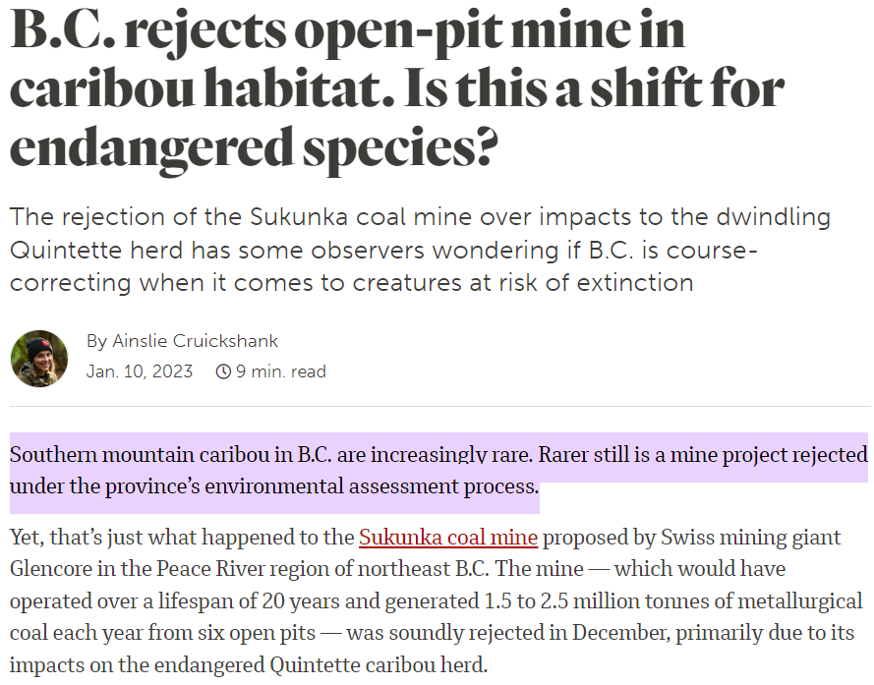
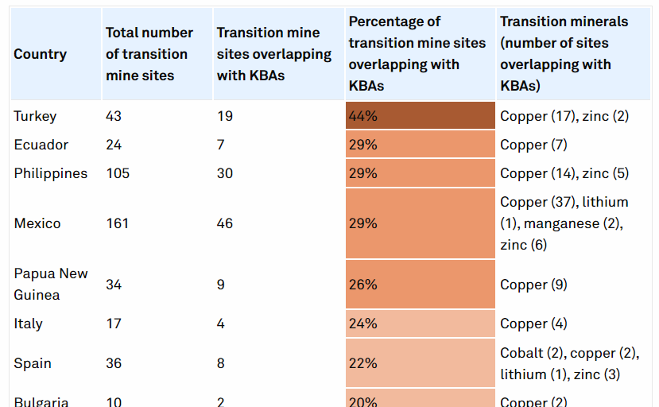
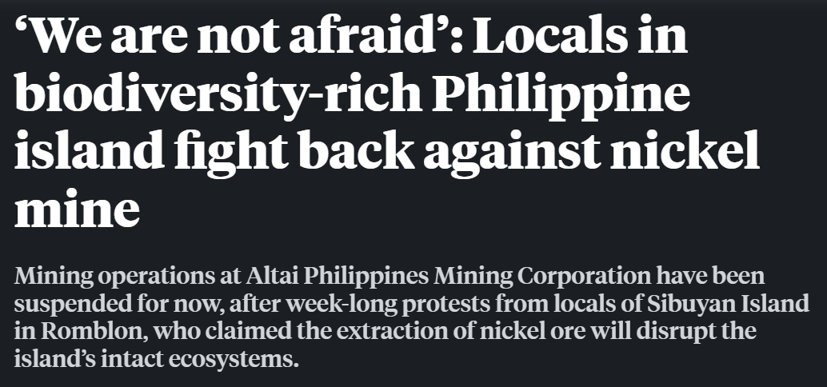
Focus area: Biodiversity
Biodiversity loss is emerging as an important contributor to supply risk

Slide 7
Focus area: Biodiversity
Land rehabilitation by top 20 mining companies
Biodiversity commitments among
selected cobalt, copper and nickel companies
125
0.5
10
100
0.4
8
5
kha
75
0.3
6
4
3
50
0.2
4
2
25
0.1
2
1
0
0
0.0
0
2018
2019
2020
2021
Nickel
Lithium
Cobalt
Mitigation hierarchy
Total land rehabilitated
Total land rehabilitated
Per million USD (right axis)
No net loss commitment
Per million USD (right axis)
Net positive impact commitment
Progress on biodiversity impacts and uptake of commitments to address them has been slow,
even as biodiversity loss is emerging as an important contributor to supply security

Slide 8
Focus area: Biodiversity
Prohibits operations in legally protected areas
Requires a commitment to no net loss
Maintain benefits of ecosystem services, respect KBAs
Copper Mark and IRMA
Copper Mark, ICMM, IRMA and TSM
Copper Mark, IRMA, TSM, and ICMM (as of January 2024)
Requires utilisation of mitigation hierarchy
Copper Mark, ICMM, IRMA and TSM
Encourages net gain/net positive impact
Copper Mark and IRMA
Standards help drive regulatory goals towards improved protection and supply risk mitigation

Slide 9
Focus area: Biodiversity
International cooperation
Sustainable Critical Minerals Alliance:
Regulatory reform
Philippines DENR A.O. 2022-04:
Public Disclosure
France Art. 29, Energy and Climate Law:
Halt and reverse biodiversity loss by 2030
Biodiversity assessment and rehabilitation plan for permitting
Public disclosure of risks related to climate change and biodiversity
Biodiversity protections are increasingly being mainstreamed into policy

Slide 10
Critical Minerals Policy Tracker 2022
Policy snapshot: Encouraging sustainable and responsible practices
 | Environmental standards | Transparency norms | Due diligence obligations | Inclusivity and gender policies | Permitting regimes
Australia
Canada
Chile
China
European Union
France
Japan
Korea
United States
United Kingdom
The 2023 update includes new policies and fills in some gaps across the three key areas: (1) Ensuring reliable and resilient supply, (2) Incentivising new supplies, and (3) Sustainable & responsible supply

Slide 11
Critical Minerals Policy Tracker 2023 Update
Policy snapshot: Encouraging sustainable and responsible practices
 | Environmental standards | Transparency norms | Due diligence obligations | Inclusivity and gender policies | Permitting regimes
Australia
Canada
Chile
China
European Union
France
Japan
Korea
United States
United Kingdom
The 2023 update includes new policies and fills in some gaps across the three key areas: (1) Ensuring reliable and resilient supply, (2) Incentivising new supplies, and (3) Sustainable & responsible supply

Slide 12
Critical Minerals Policy Tracker 2023 Update
Focus of updates
Broader country scope – now covering over 35 countries
More than 500 new entries, including new and updated policies identified by IEA members
Expanded coverage of policies aimed at reducing environmental, social and governance impacts
General trends in recent policies
New strategic plans (e.g. Sweden, Korea)
Sustainability due diligence laws (e.g. France, EU)
Reforms of mining codes or permitting regimes with sustainability measures (e.g. Mexico, Colombia)
Tax credit schemes for mineral exploration (e.g. Ukraine, Canada)
Increasing international cooperation agreements (e.g. EU Strategic Partnerships)
https://www.iea.org/data-and-statistics/data-tools/critical-minerals-policy-tracker

